Slide 1
Computational logic homework – semantic tableaux method
Constantin Marian – Group 912

Slide 2

Exercise 7.2
Using the semantic tableaux method check whether the following logical consequences hold.
$$(∀x)(∀y)(Q(x,y)→P(x,y)), (∀z)Q(z,z)\text{⊧}\text{(}∀x)P(x,x)$$

Slide 3
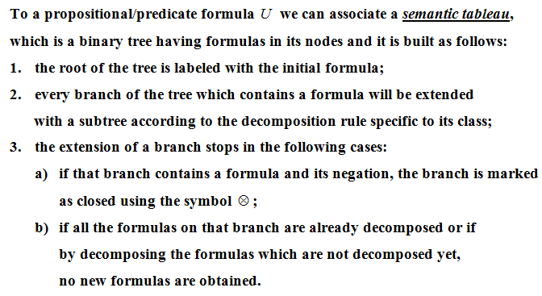
Theoretical results
Construction of a semantic tableau

Slide 4
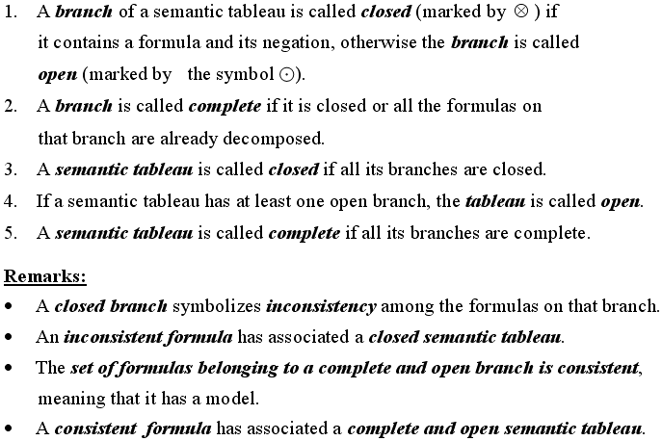
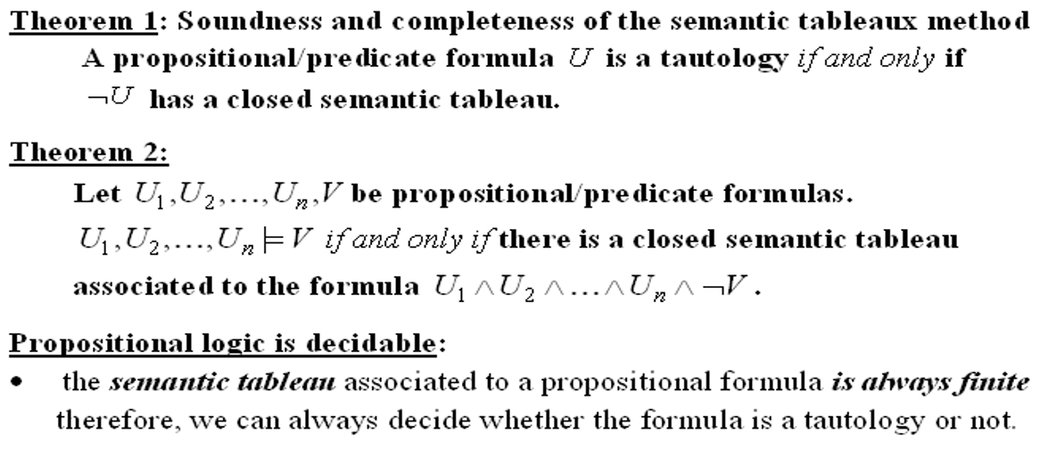
Definitions

Slide 5
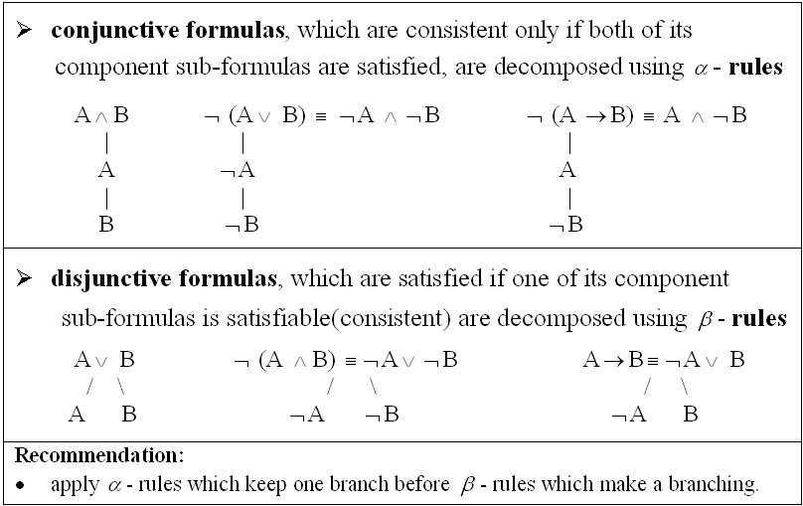
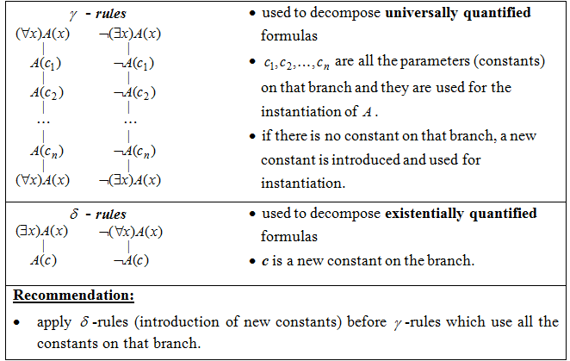
Decomposition rules
α - rules
γ - rules
β - rules
𝛿 - rules

Slide 6
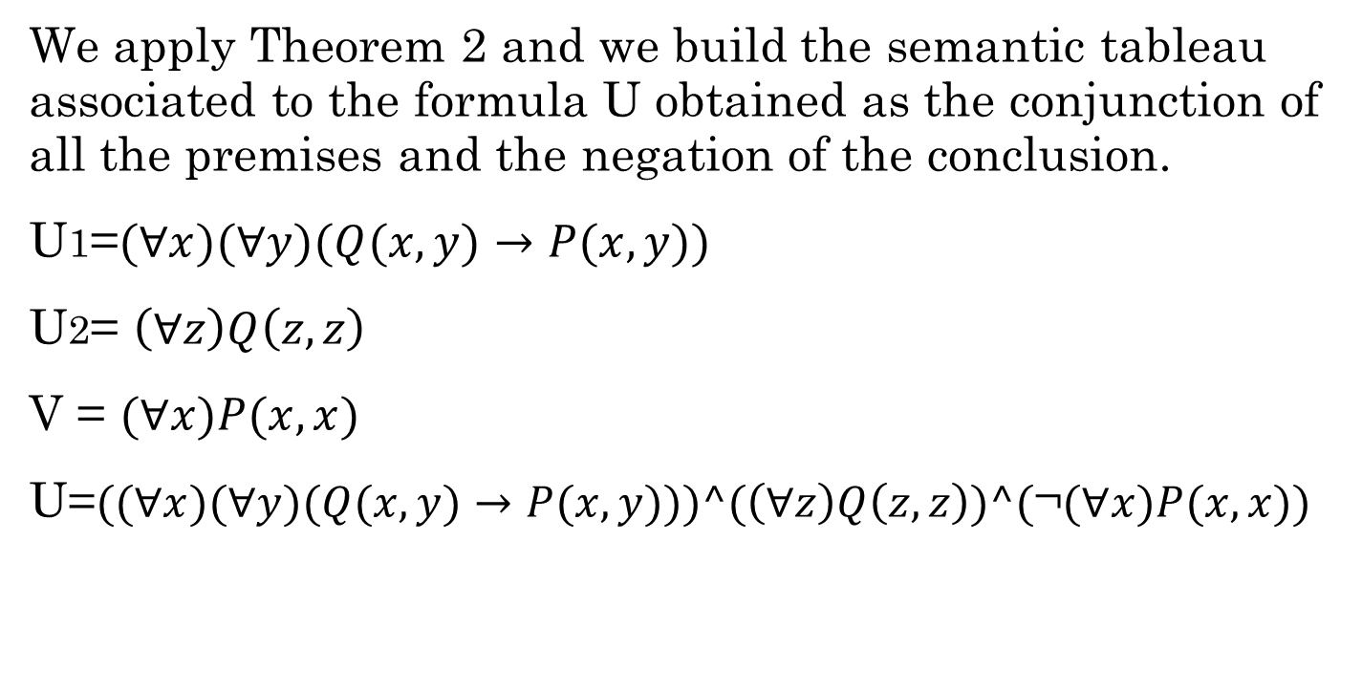
Solution
We apply Theorem 2 and we build the semantic tableau associated to the formula U obtained as the conjunction of all the premises and the negation of the conclusion.
U1=$(∀x)(∀y)(Q(x,y)→P(x,y))$
U2= $\left(∀z\right)Q\left(z,z\right)$
V = $\text{(}∀x)P(x,x)$
U=$((∀x)(∀y)(Q(x,y)→P(x,y)))\text{^}(\left(∀z\right)Q\left(z,z\right))\text{^(}\text{¬}\text{(}∀x)P(x,x))$

Slide 7
$((∀x)(∀y)(Q(x,y)→P(x,y)))\text{^}(\left(∀z\right)Q\left(z,z\right))\text{^(}\text{¬}\text{(}∀x)P(x,x))$ (1)
apply α rule on (1)
$(∀x)(∀y)(Q(x,y)→P(x,y))$ (2)
$\left(∀z\right)Q\left(z,z\right)$ (3)
$\text{¬}\text{(}∀x)P(x,x)$ (4)
apply 𝛿 rule on (4), c is a new constant
$\text{¬}P(c,c)$
apply γ rule on (2), c is used for instantiation
$(∀y) (Q(c,y)→P(c,y))$ (5)
$(∀x)(∀y) (Q(x,y)→P(x,y))$ copy of formula (2)
apply γ rule on (3), c is used for instantiation
$Q\left(c,c\right)$
$\left(∀z\right)Q\left(z,z\right)$ copy of formula (3)
apply γ rule on (5), c is used for instantiation
$(Q(c,c)→P(c,c))$ (6)
$(∀y) (Q(c,y)→P(c,y))$ copy of formula (5)
apply β rule on (6)
$\text{¬}Q(c,c)$
$P(c,c)$
closed branch
closed branch

Slide 8
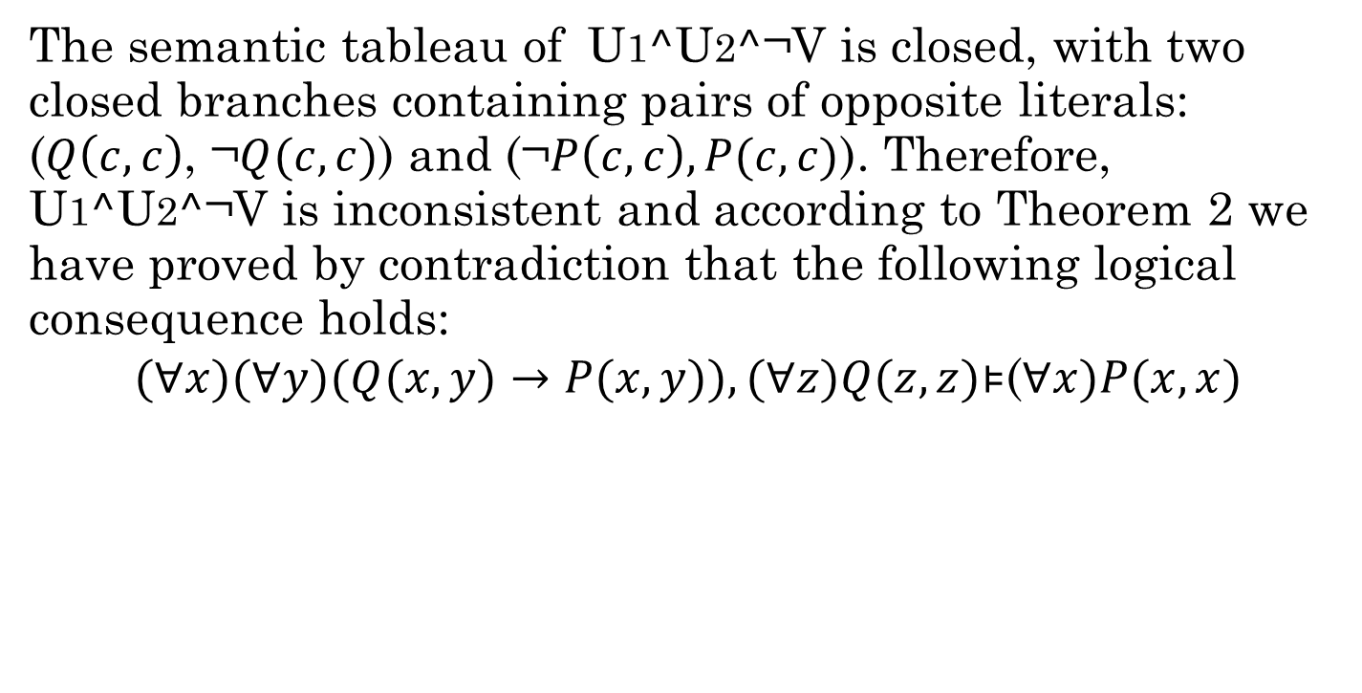
Conclusion
The semantic tableau of U1$\text{^}$U2$\text{^}\text{¬}$V is closed, with two closed branches containing pairs of opposite literals: ($Q\left(c,c\right)$, $\text{¬}Q(c,c)$) and ($\text{¬}P\left(c,c\right),P(c,c)$). Therefore, U1$\text{^}$U2$\text{^}\text{¬}$V is inconsistent and according to Theorem 2 we have proved by contradiction that the following logical consequence holds:
$$(∀x)(∀y)(Q(x,y)→P(x,y)), (∀z)Q(z,z)\text{⊧}\text{(}∀x)P(x,x)$$

